Slide 1


Capstone Project – The Battle of Neighborhoods
Selecting a location for coffee shop opening
Pai, Yen-Fang

Slide 2
Selecting a suitable location for new coffee shop opening
A lot of people would like to have their own business, during these years one of the most popular is coffee shop in Taiwan. It’s easy to get a cup of coffee, like convenience store just right at the corner.
It’s important to select the location for new coffee shop opening.

Slide 3
Data acquisition
Collecting data from Foursquare API.
Based on the location where I am as center, radius = 2km, to find all coffee shops in this area.
Get the data of the number of shops and location, and names.

Slide 4
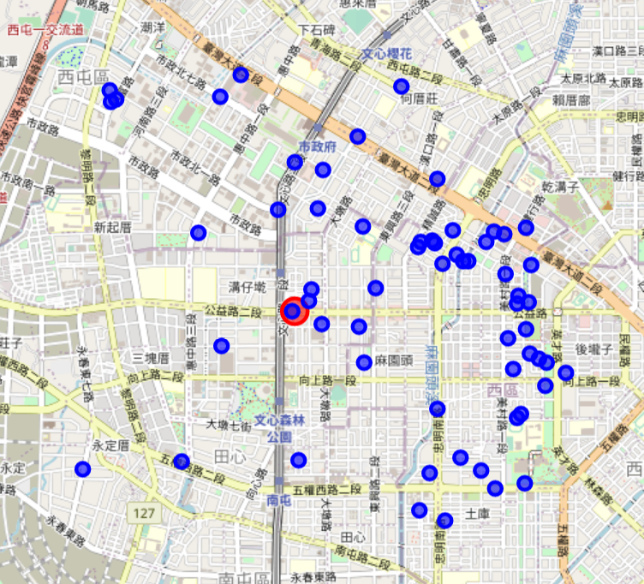
Visualizing the distribution of coffee shops
From left map, blue points are coffee shops. We can see the coffee shops are located on east side more than west side.
Let's try to see what's the distribution of restaurant. To check if the population makes the distribution like this.

Slide 5
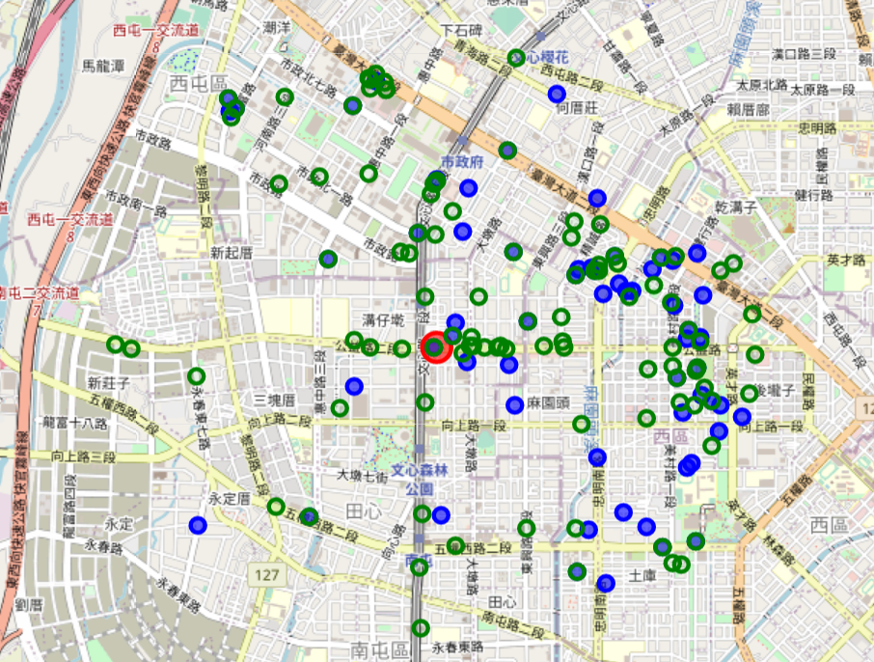
The distribution of coffee shops and restaurants
From map, seems restaurants are distributed more randomly than coffee shop.
Suppose population is not resulting in huge difference in restaurant opening location.
*Green points are restaurant
*Blue points are coffee shops

Slide 6
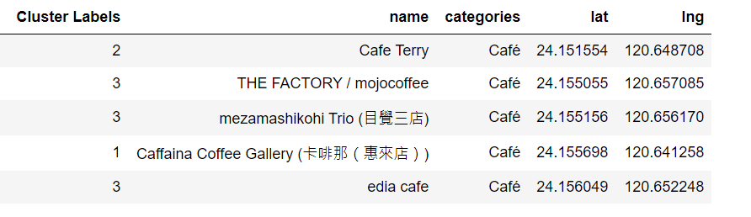
Analysis
Since there is no detailed information of ''Likes","Tips" in Foursquare for these coffee shops in Taichung. Thus, we cluster the shops and find a not crowded area.
Set 4 clusters and adding cluster labels.

Slide 7
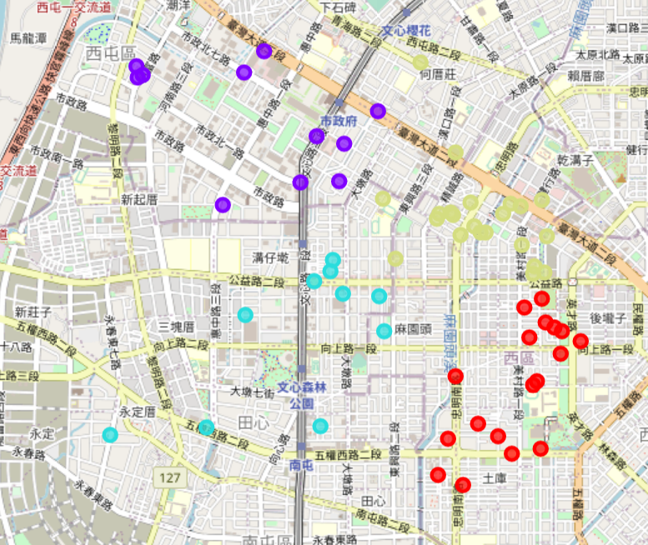
Results
From left, we can see the light blue and purple area are not so dense of coffee shops distribution.
Light blue and purple area should be better area for coffee shop opening.

Slide 8
Conclusion
According to the maps, finally we choose the purple area for new coffee shop opening.
It is the area with City Hall, also a new developed area with shopping mall and residential district .
It’s easier have parling lot and expect to have more people coming.
A better way for analysis would be taking data from google API and getting population data to better analyze the current situation then decide a location for coffee shop opening. The information from Foursquare is not enough for the analysis.

